Slide 1
BookBarns
(Jinali Ghoghari)

Slide 2
Index
Introduction
Scope
Objectives
Interface Design
Future Scope
Limitation

Slide 3
Introduction
BookBarns is a web-based PHP CI application with MYSQL
database. BookBarns provides platform where one can buy
or sell old books from various categories. User can like or give
review of a particular book.

Slide 4
Basic Information
Project Title | BookBarns
Organization | Flaky Tech
Front End Tool | PHP with CI
Back End Tool | MySQL
Other Tools | HTML5, CSS3 ,BOOTSTRAP
Project Category | Web Based Application
Project Associates | Two
Internal Project Guide | Miss Leeba John Mrs. Aditi Bhutani
Submitted By | Shreena Gabani(023) Amisha Kanani(041)

Slide 5
Advantages
BookBarns will be boon for Book-Worms.
We strongly believe that passion for learning should not be compromised for any factor especially because of money.
Thus, our main goal is to provide all kinds of books at minimum value.
For doing so this website will provide facility of buying second hand books.
Instead of spending huge amount of money on purchasing new books our users can buy books at a very small amount.
Users can also sell their old books that they don’t need any longer. Users can purchase these books directly from seller and can do bargaining, too.

Slide 6
Scope Of the system
Admin
Admin can manage User, category, sub category and other entities of database.
User
User can access several entities of database including managing selling and buying of books and do inquiry directly with other user.
Visitor
Visitor can view books and reviews etc.

Slide 7
Objective
Provide the system administrator with easy interface for different
administrative tasks such as Searching, Addition, Deletion and
Updating of different entities.
The System should properly maintain user privilege i.e. it should
only allow registered members to access certain features, which it
should not allow for unregistered users.
Only administrator will have all privileges.
Members will have limited access privileges.

Slide 8
Interface Design
Admin Side

Slide 9
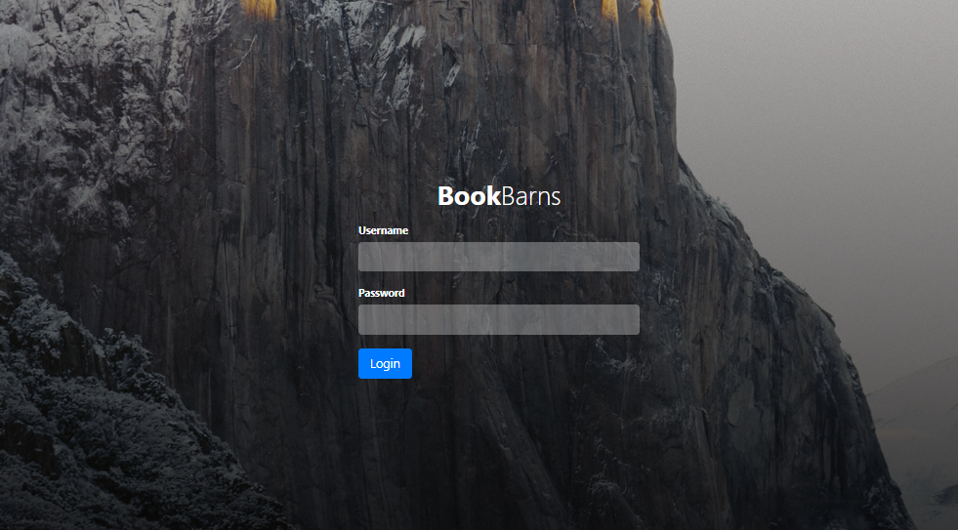
Admin Login

Slide 10
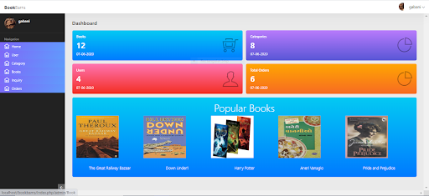
Admin Home Page

Slide 11
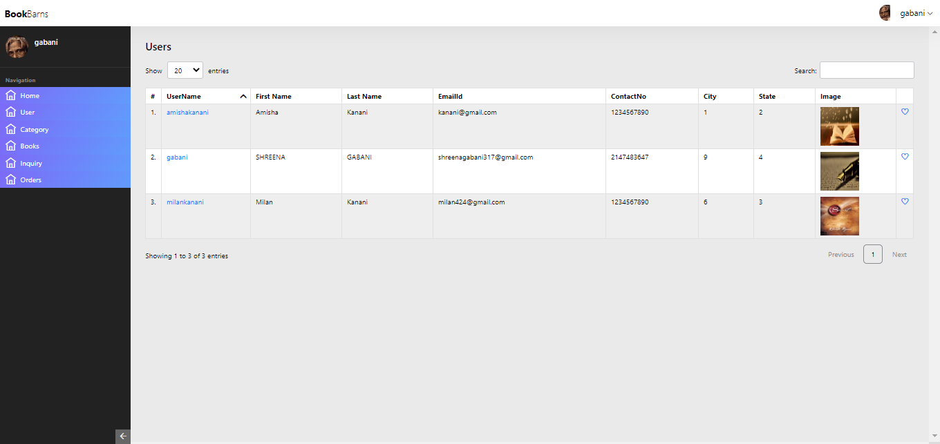
User Page

Slide 12
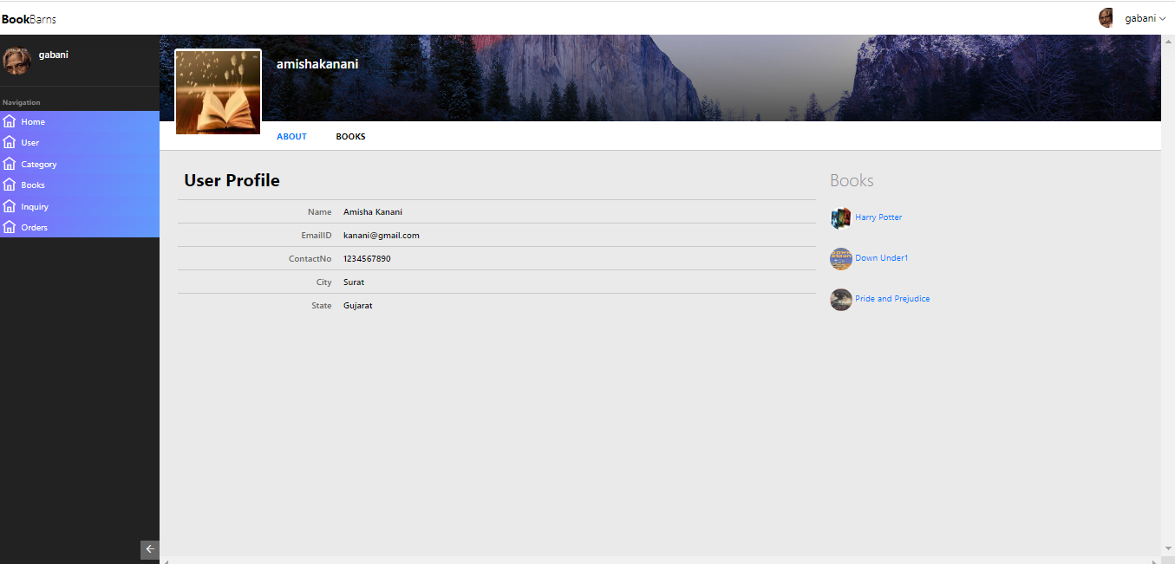
User more Info

Slide 13
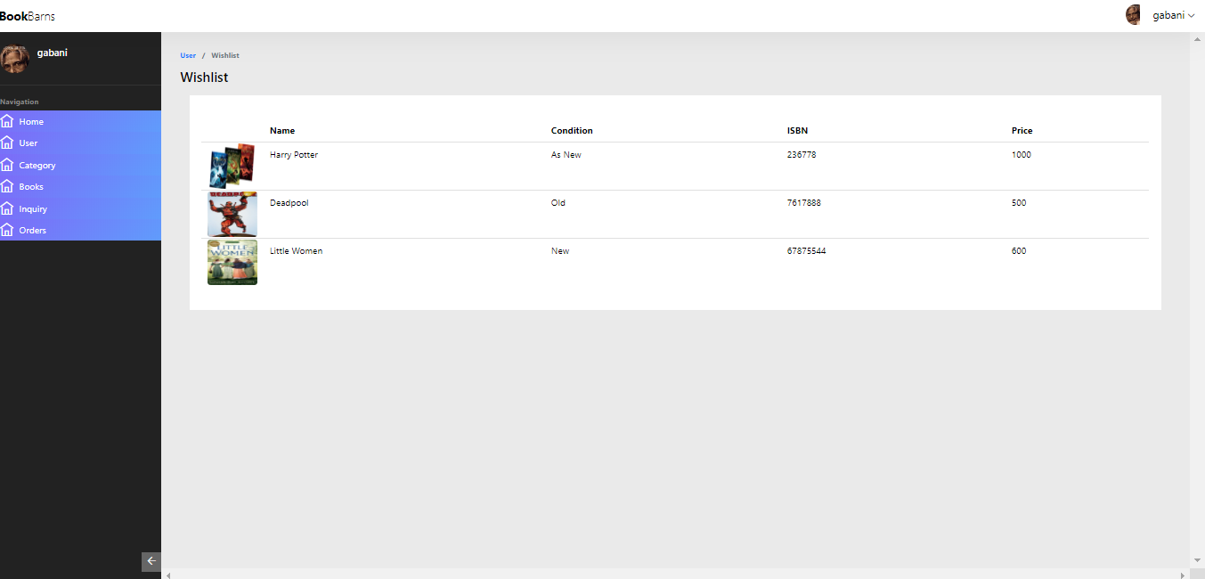
User Wishlist

Slide 14
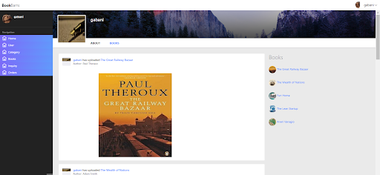
User’s book

Slide 15
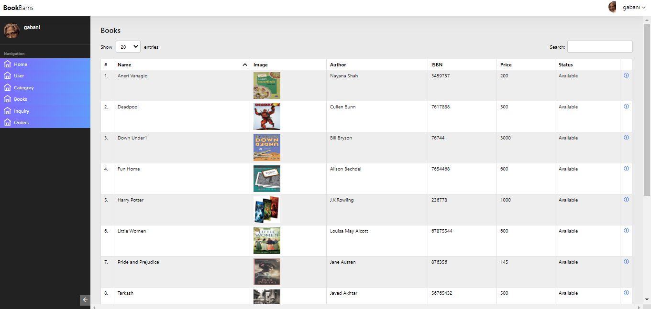
Books

Slide 16
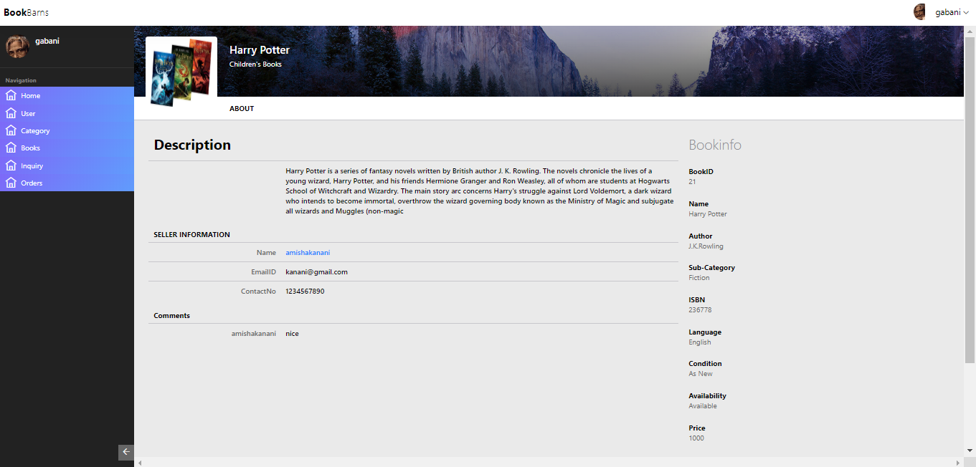
Book Info

Slide 17
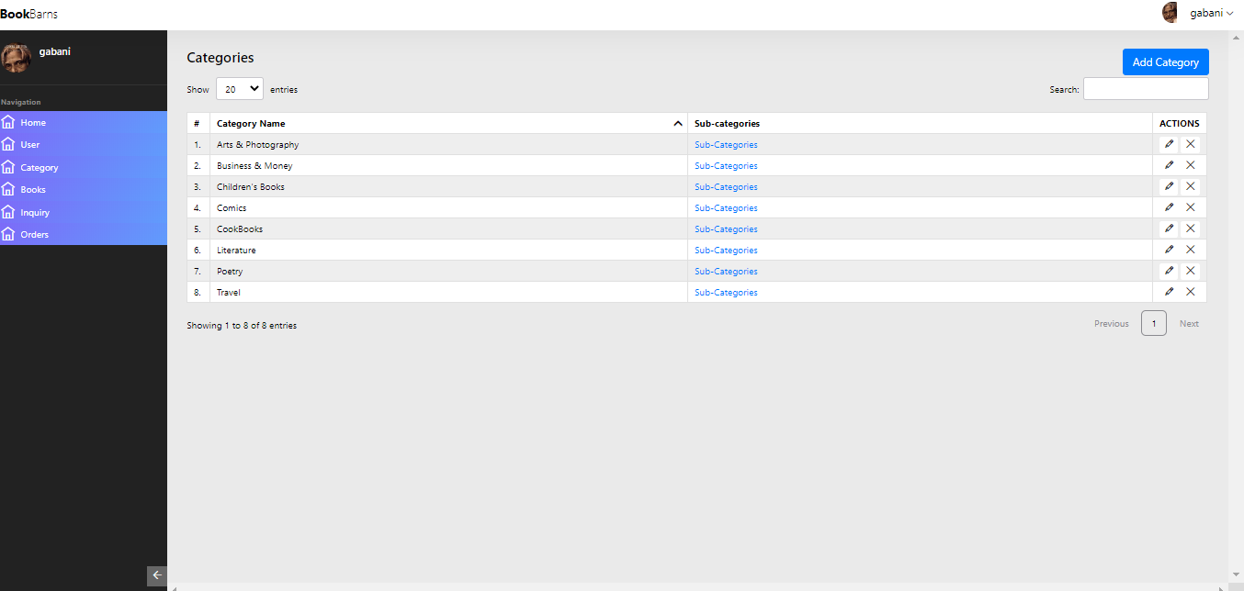
Manage Category

Slide 18
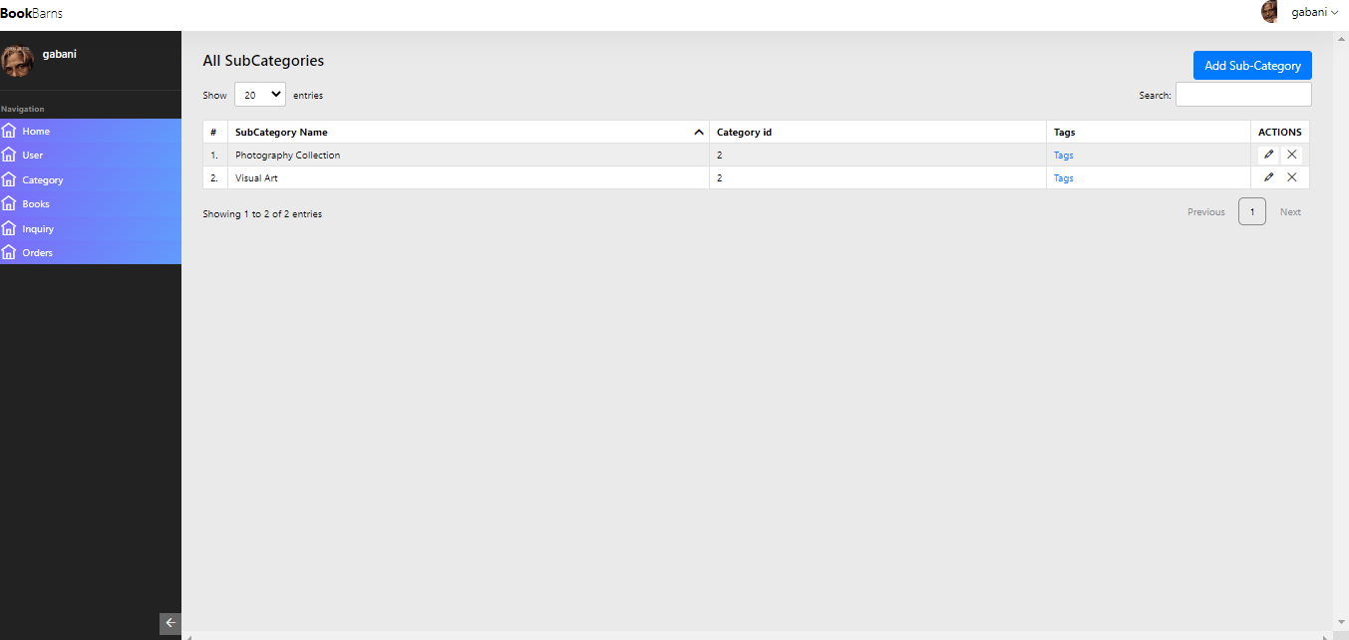
Manage Subcategory

Slide 19
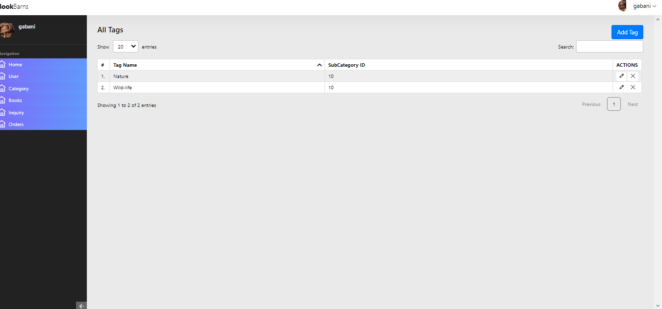
Manage Tags

Slide 20
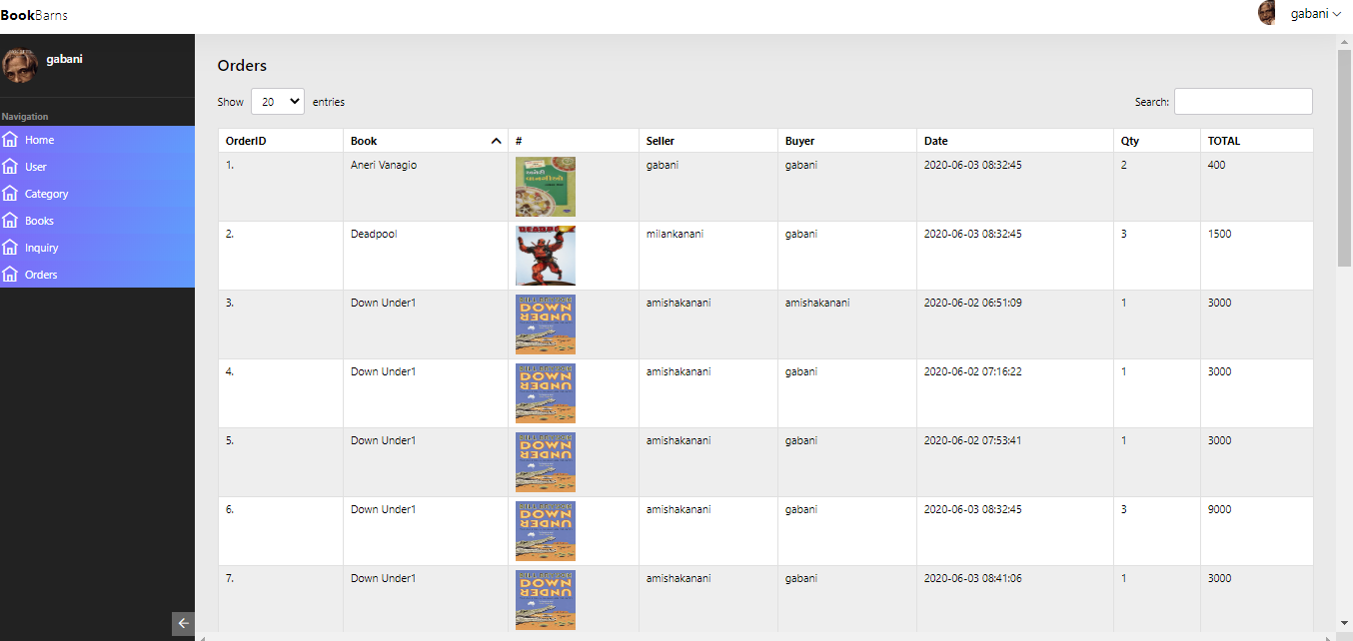
Orders

Slide 21
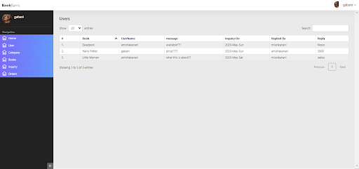
Inquiries

Slide 22
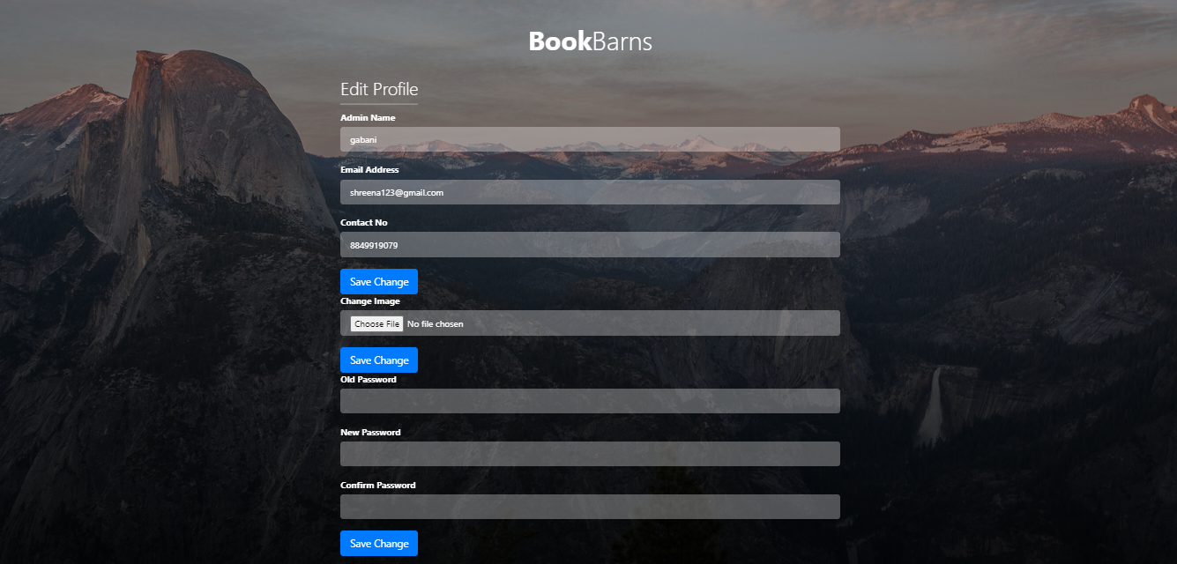
Manage Admin Profile

Slide 23
User Side

Slide 24
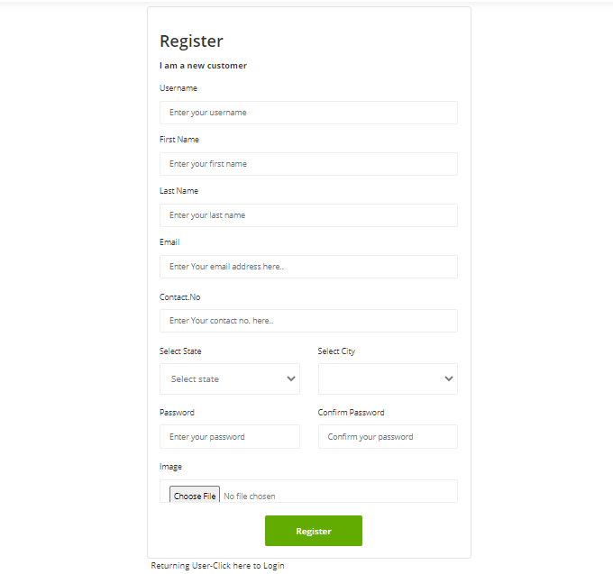
Registration

Slide 25
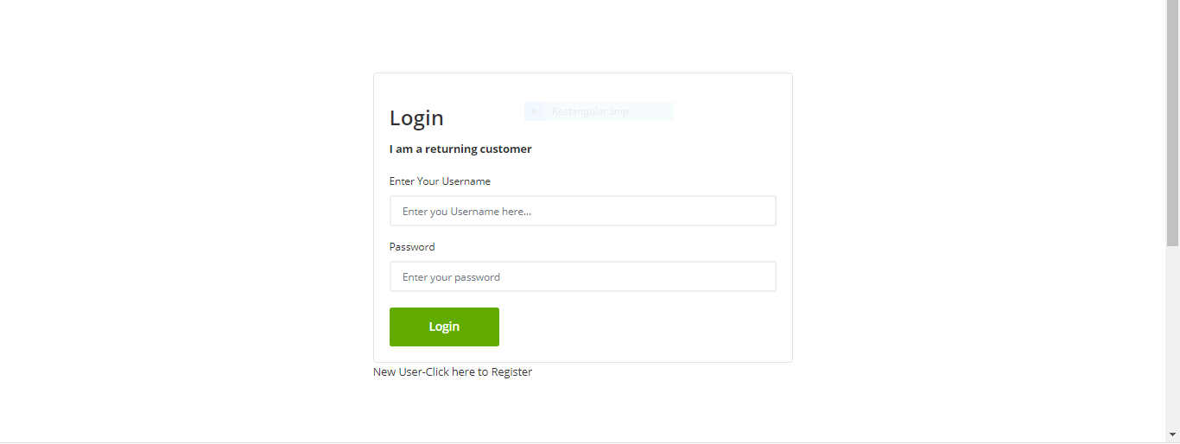
Login

Slide 26
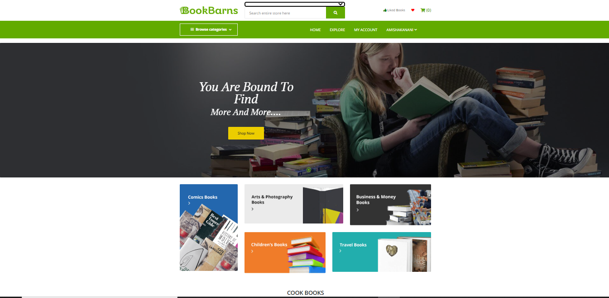
Home Page

Slide 27
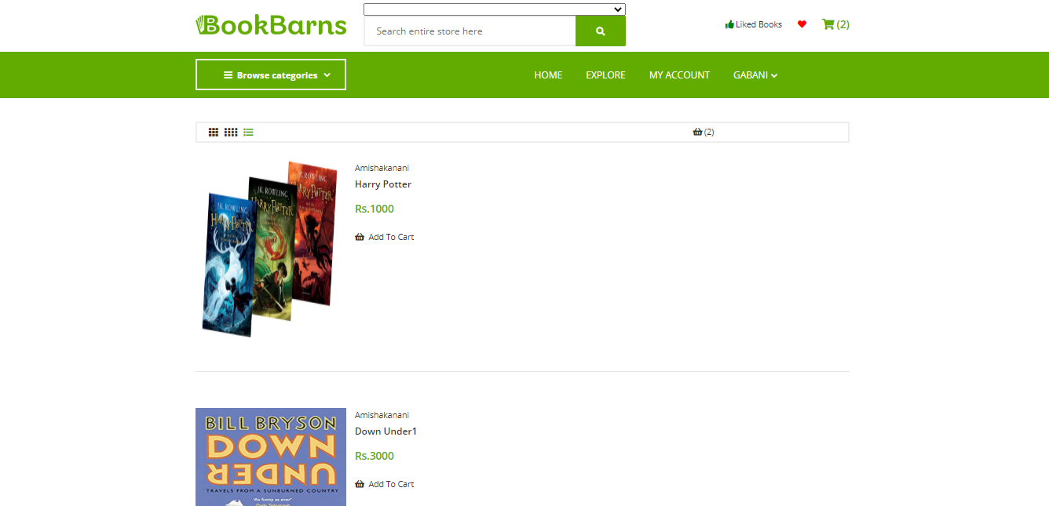
Explore books

Slide 28
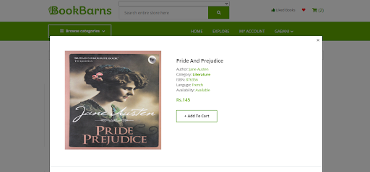
Book Quick View (Modal)

Slide 29
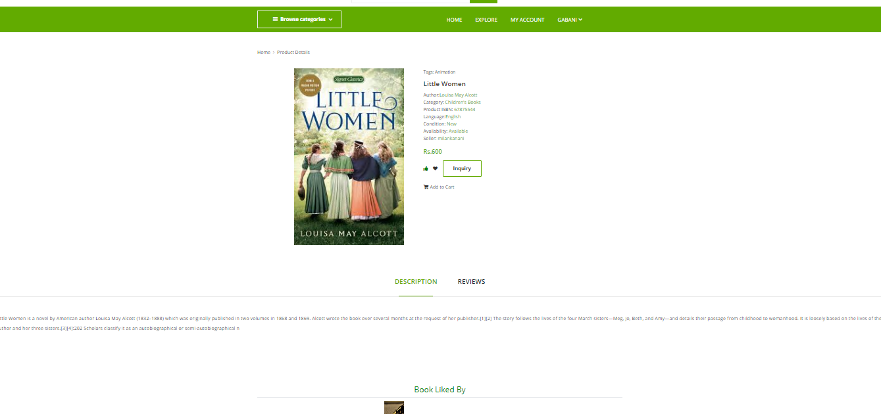
Book Info

Slide 30
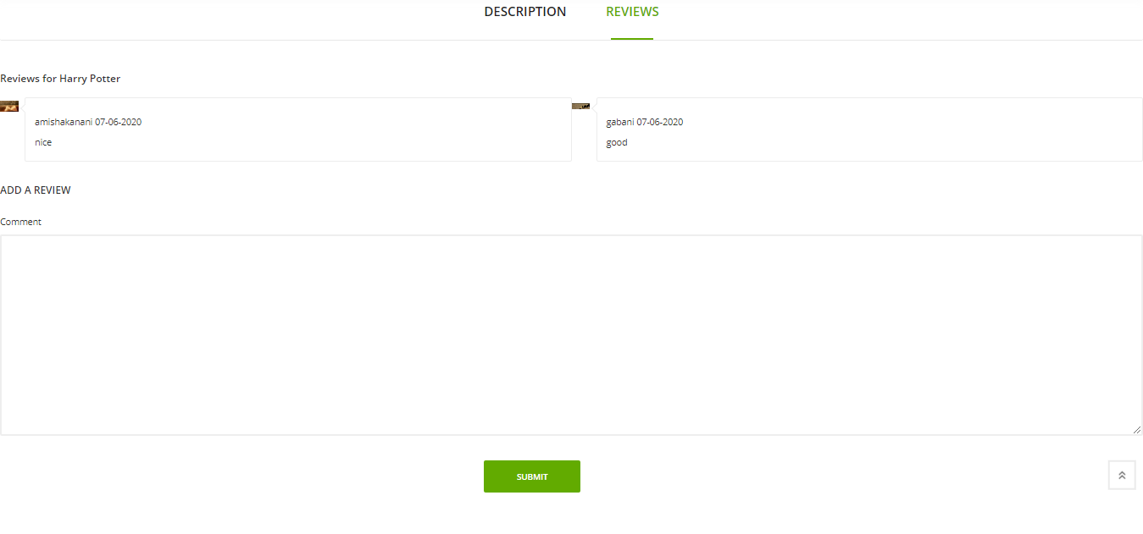
View/Give Feedback

Slide 31
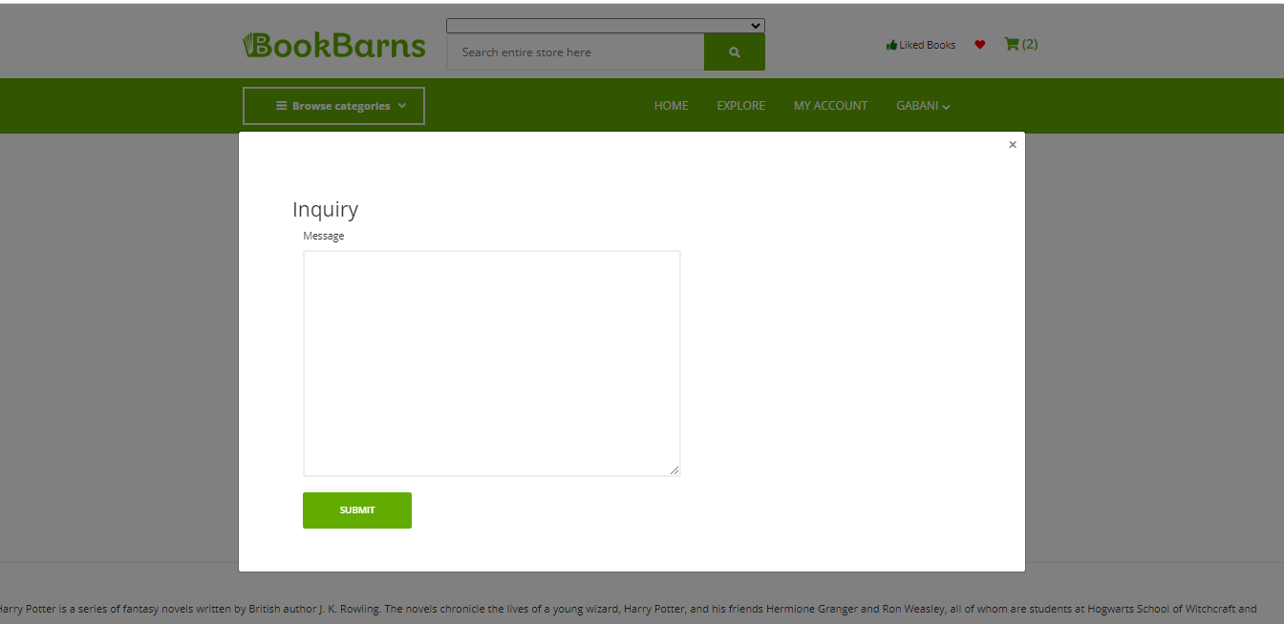
Book Inquiry (Modal)

Slide 32
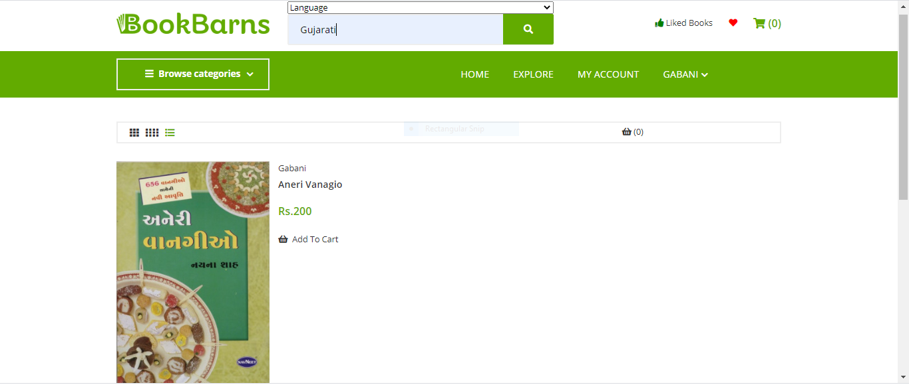
Search books

Slide 33
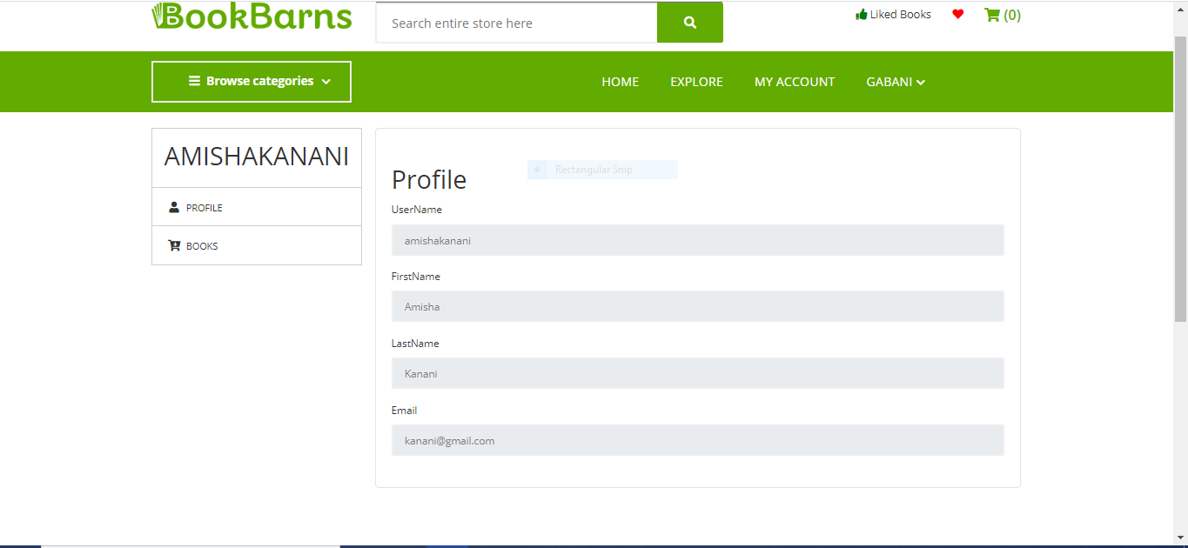
Seller’s Profile

Slide 34
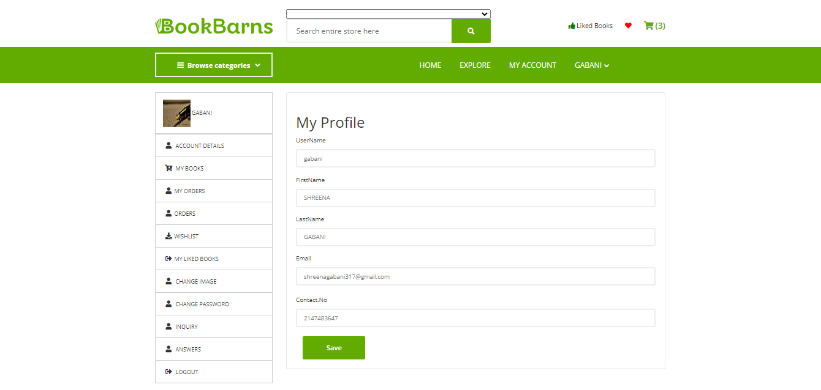
Mange User Profile

Slide 35
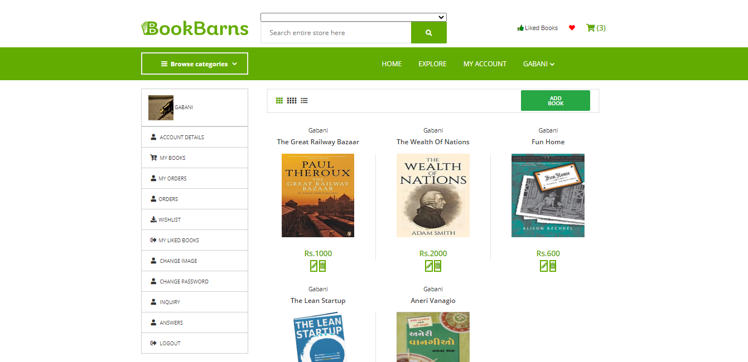
Manage User Book

Slide 36
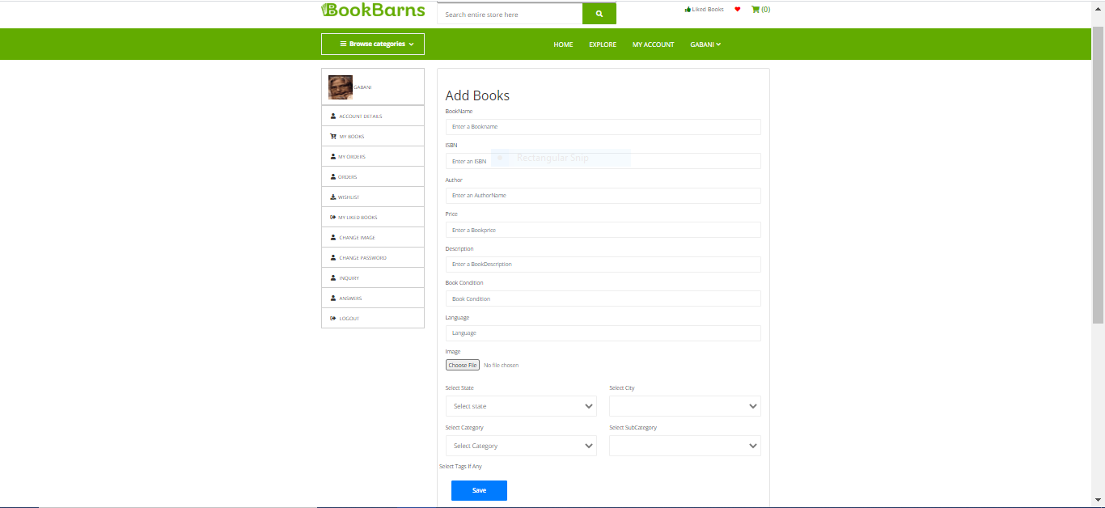
Add Book

Slide 37
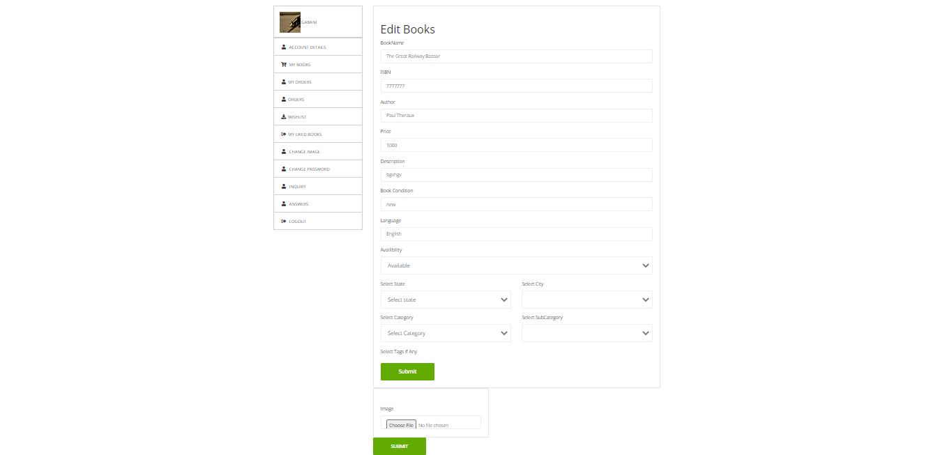
Edit Book

Slide 38
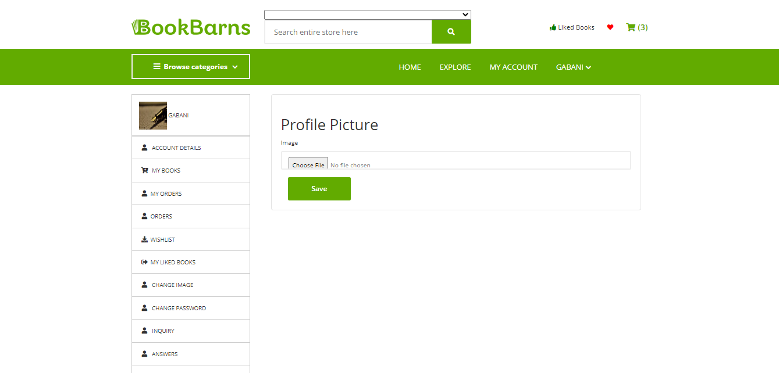
Change Profile Picture

Slide 39
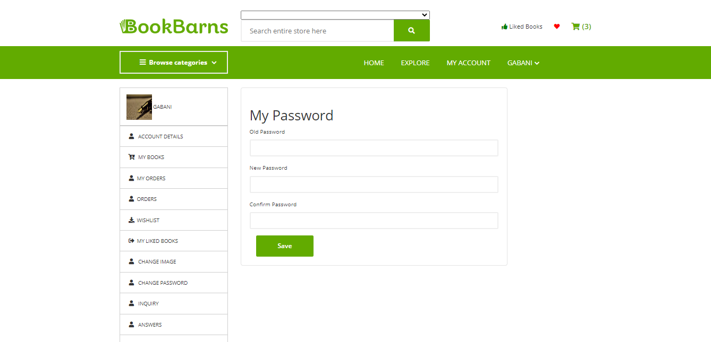
Change Password

Slide 40
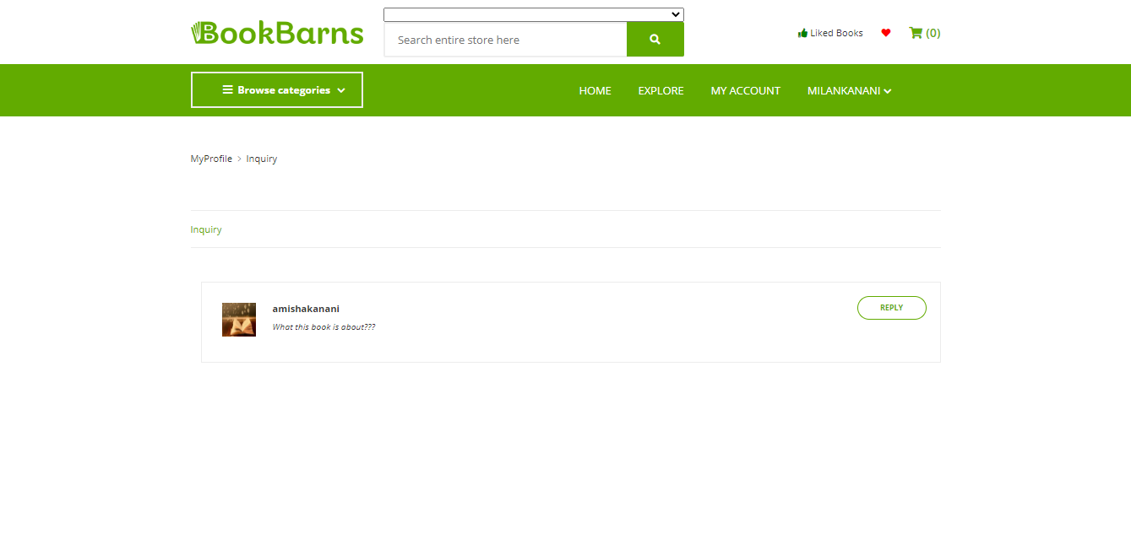
Inquiries

Slide 41
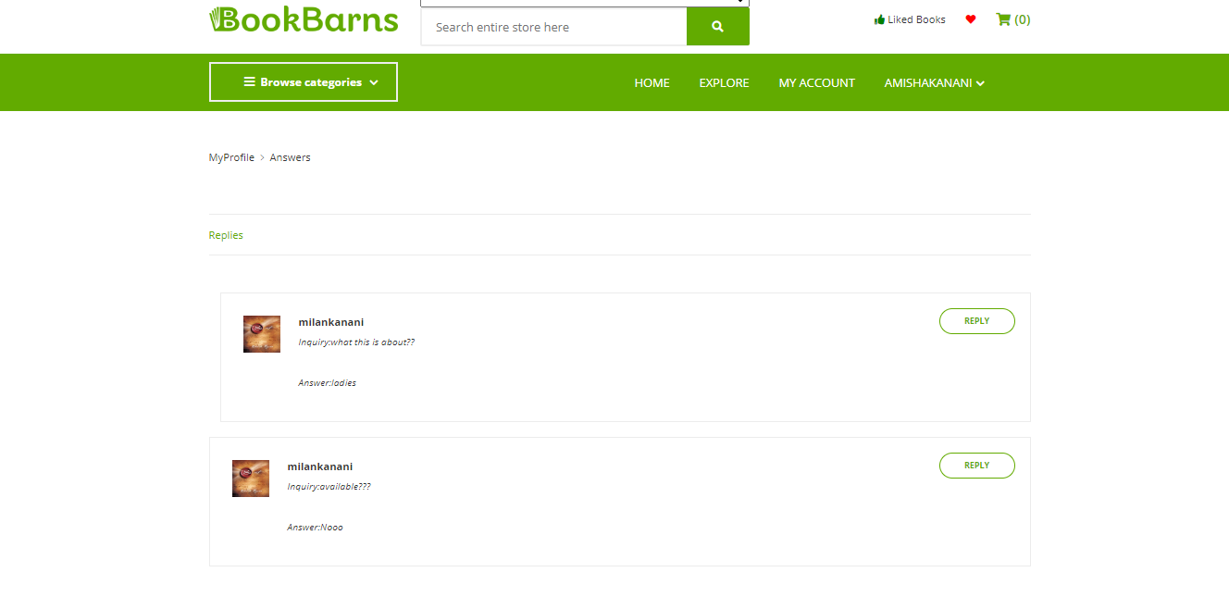
Replies

Slide 42
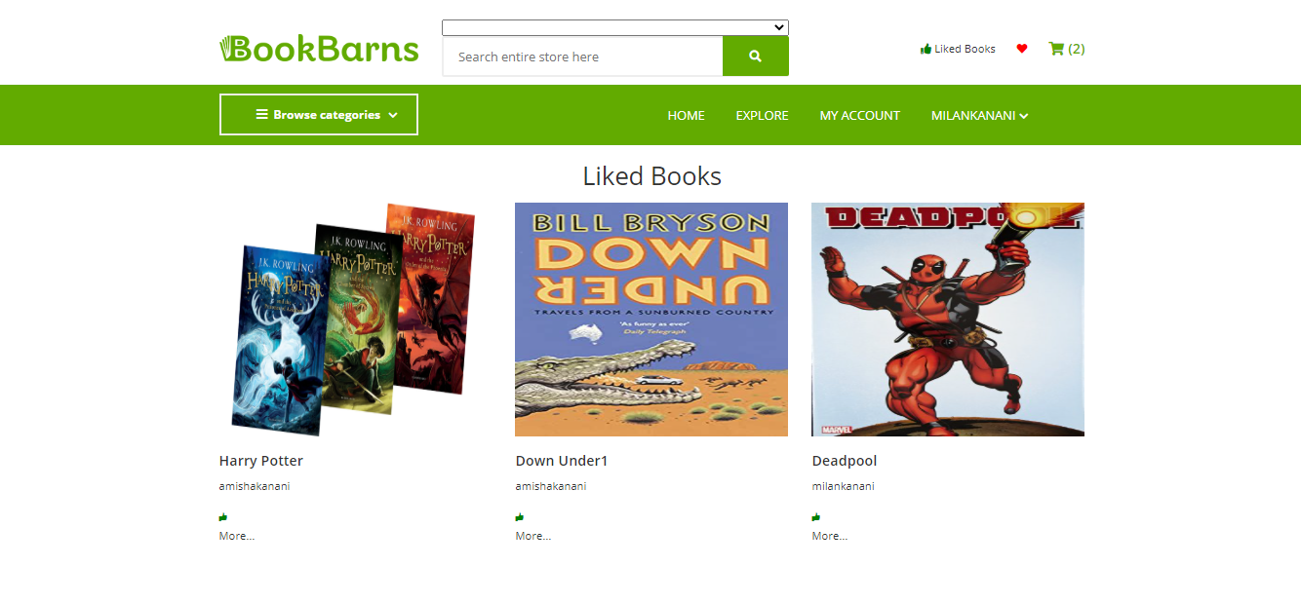
User’s Liked Books

Slide 43
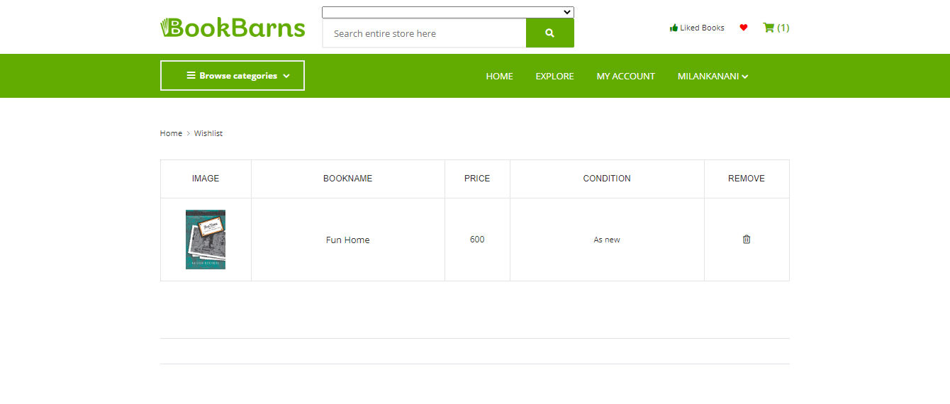
User Wishlist

Slide 44
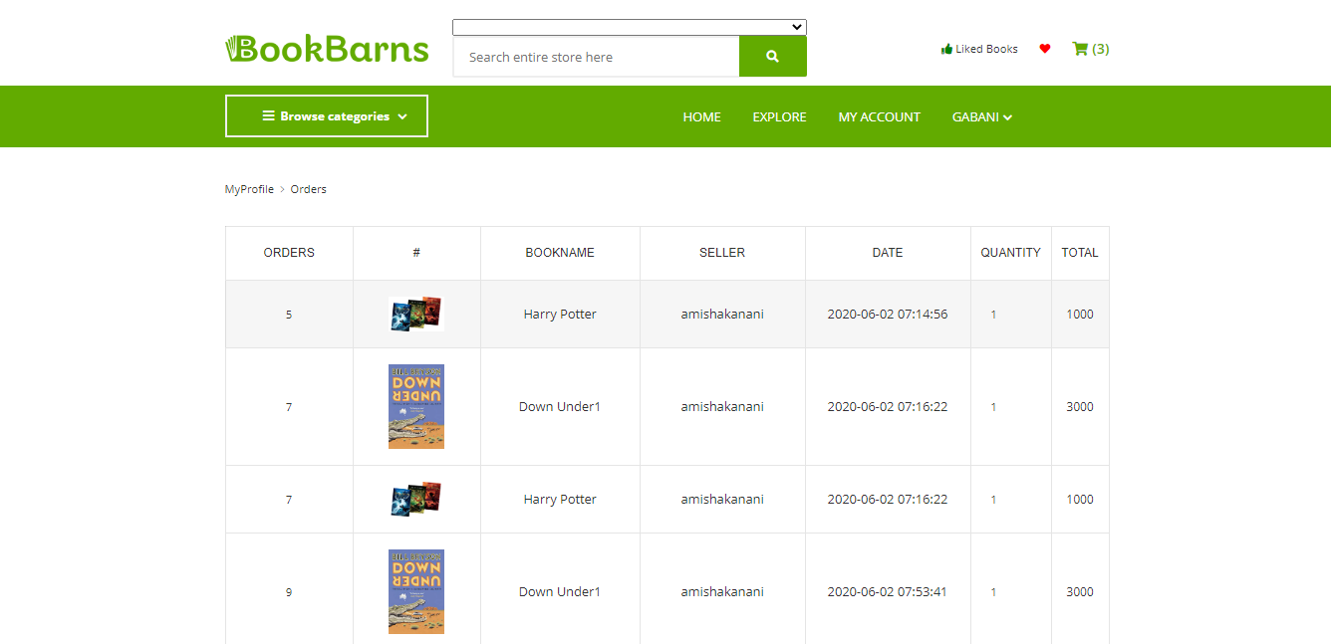
User Order

Slide 45
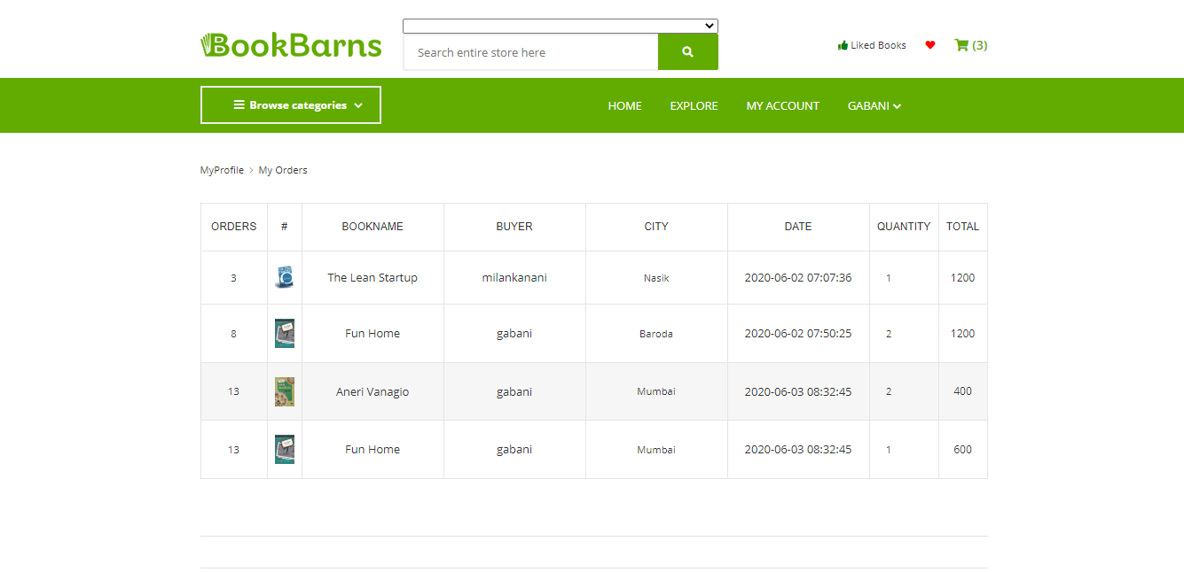
User’s Book Order

Slide 46
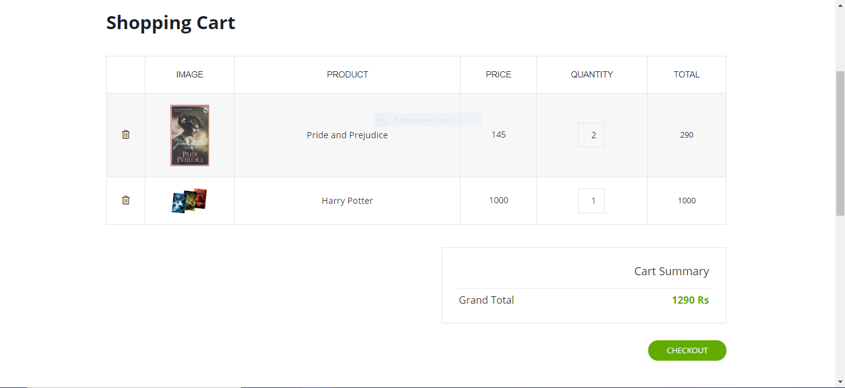
User Cart

Slide 47
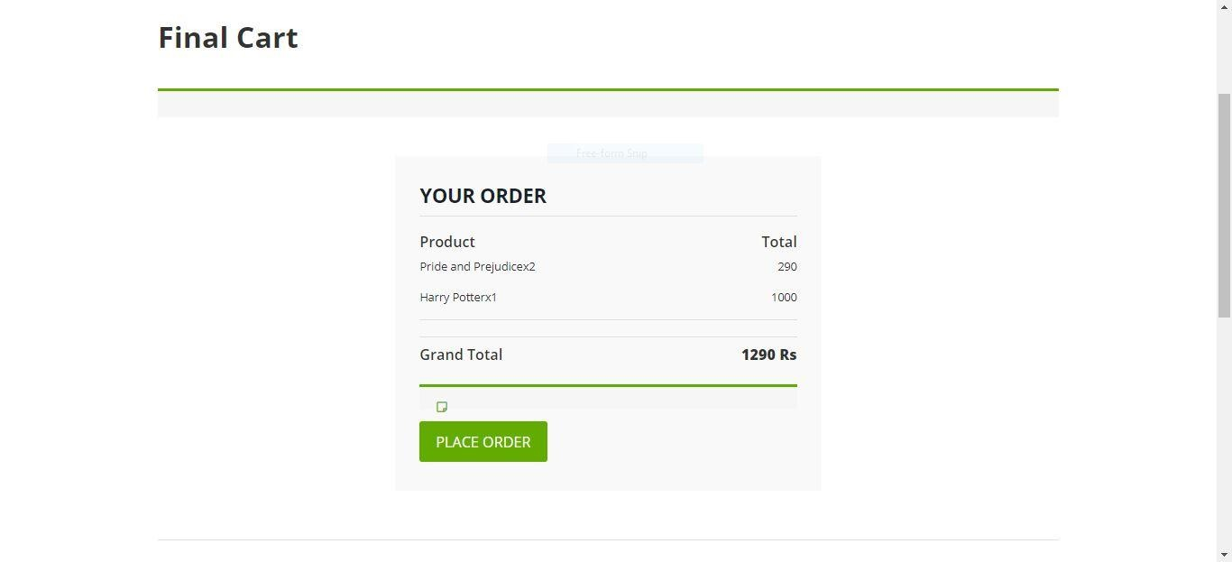
Order Confirmation

Slide 48
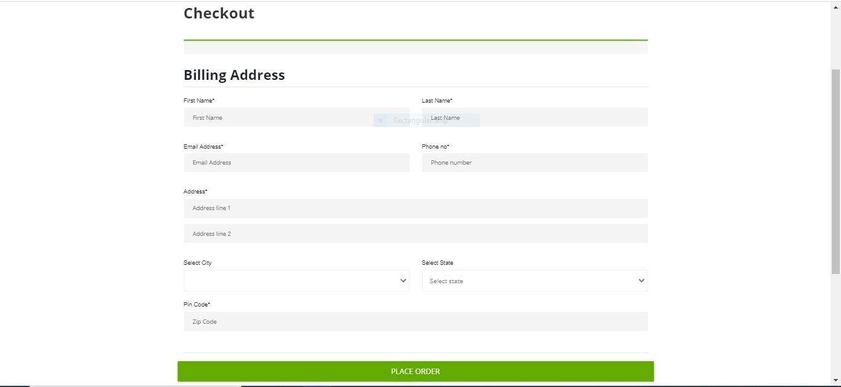
Shipping Address

Slide 49
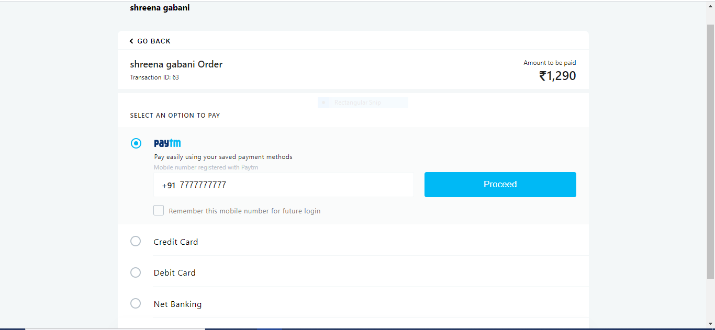
Payment Method

Slide 50
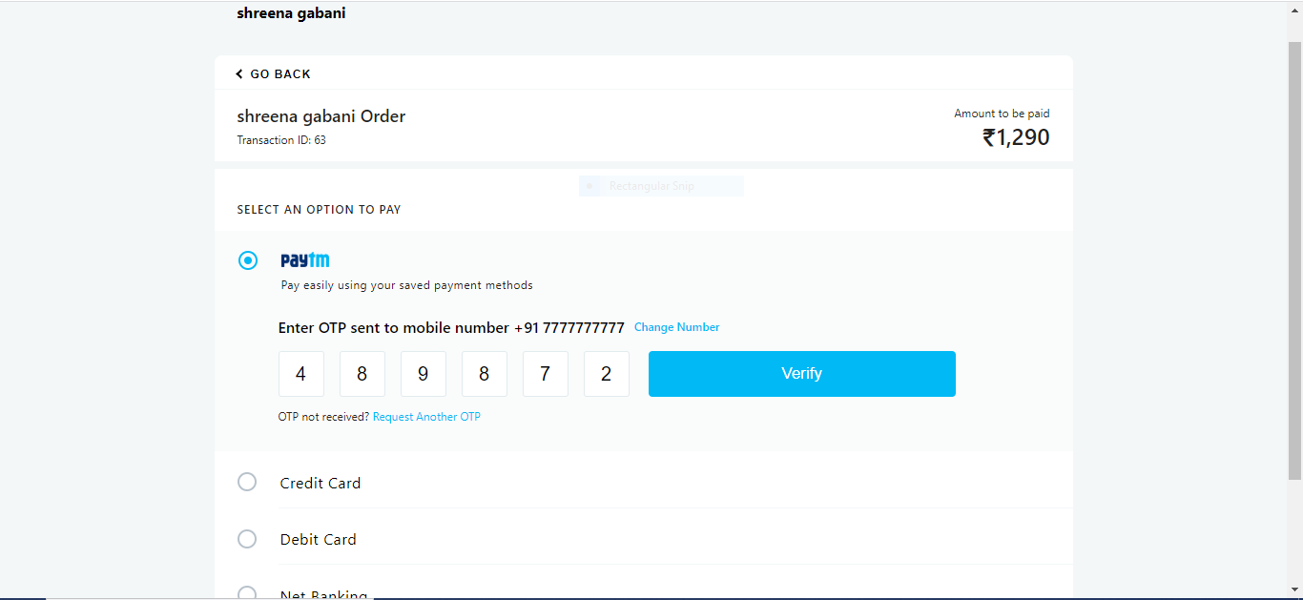
OTP Confirmation

Slide 51
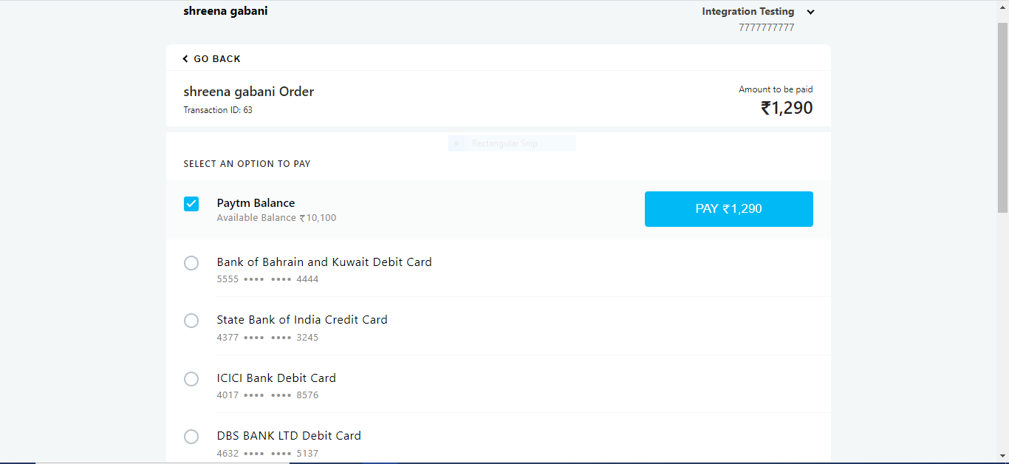
Payment

Slide 52
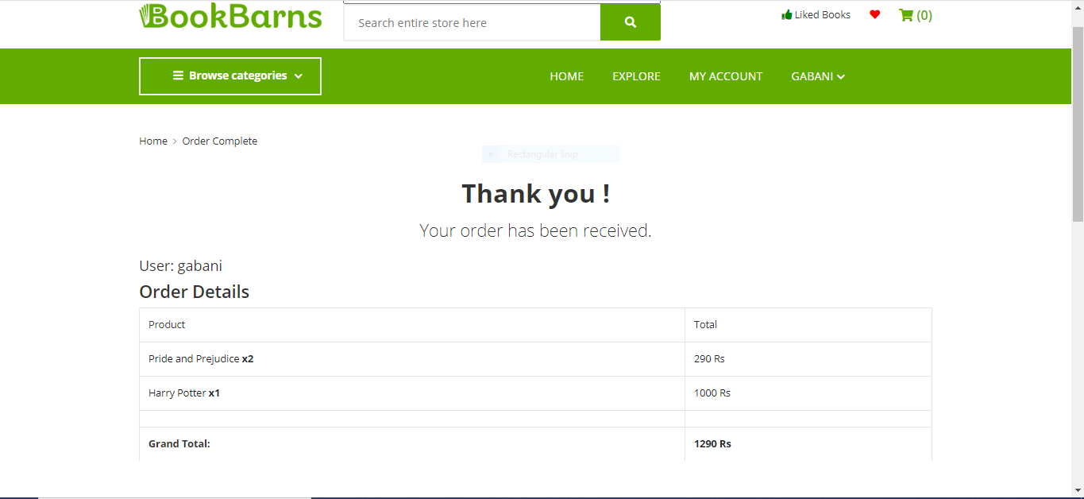
Order Receipt

Slide 53
Future Scope
In future users can make request about particular
book that they want. Other user can see that request
and when that book is uploaded for sell requesting user
will get message.
Online video chat with seller to see books’ actual
condition.
User will get the books on rent.
User can exchange the book with other user.

Slide 54
Limitation
Currently in the system user can buy books via
another user only through chatting feature of the website
Currently user cannot track their order and user can
not cancel order once it’s placed.

Slide 55
Thank You

